Slide 1
Parallel Computing
Prepared by
AVITA KATAL
Assistant Professor(SS)
School of Computer Science
UPES

Slide 2
Contents
Introduction
Parallel vs Distributed
Parallel Processing
Hardware architectures for parallel processing
Approaches to parallel programming
Levels of parallelism

Slide 3
1. Introduction
The two fundamental and dominant models of computing are sequential and parallel.
The sequential computing era began in the 1940s; the parallel (and distributed) computing era followed it within a decade.
The four key elements of computing developed during these eras are architectures, compilers, applications, and problem-solving environments.
The computing era started with a development in hardware architectures, which actually enabled the creation of system software—particularly in the area of compilers and operating systems—which support the management of such systems and the development of applications.

Slide 4
2. Parallel vs distributed
The terms parallel computing and distributed computing are often used interchangeably, even though they mean slightly different things.
The term parallel implies a tightly coupled system, whereas distributed refers to a wider class of system, including those that are tightly coupled.
More precisely, the term parallel computing refers to a model in which the computation is divided among several processors sharing the same memory.
The architecture of a parallel computing system is often characterized by the homogeneity of components: each processor is of the same type and it has the same capability as the others.
The shared memory has a single address space, which is accessible to all the processors.
Parallel programs are then broken down into several units of execution that can be allocated to different processors and can communicate with each other by means of the shared memory.

Slide 5
2. Parallel vs distributed contd…
Originally, parallel systems only those architectures that featured multiple processors sharing the same physical memory and that were considered a single computer.
Over time, these restrictions have been relaxed, and parallel systems now include all architectures that are based on the concept of shared memory, whether this is physically present or created with the support of libraries, specific hardware, and a highly efficient networking infrastructure.
For example, a cluster of which the nodes are connected through an InfiniBand network and configured with a distributed shared memory system can be considered a parallel system.
The term distributed computing encompasses any architecture or system that allows the computation to be broken down into units and executed concurrently on different computing elements, whether these are processors on different nodes, processors on the same computer, or cores within the same processor.
Even though it is not a rule, the term distributed often implies that the locations of the computing elements are not the same and such elements might be heterogeneous in terms of hardware and software features.

Slide 6
3. Parallel Processing
Processing of multiple tasks simultaneously on multiple processors is called parallel processing.
The parallel program consists of multiple active processes (tasks) simultaneously solving a given problem.
A given task is divided into multiple subtasks using a divide-and-conquer technique, and each subtask is processed on a different central processing unit (CPU).
Programming on a multiprocessor system using the divide-and-conquer technique is called parallel programming.

Slide 7
3. Parallel Processing contd…
The development of parallel processing is being influenced by many factors. The prominent among them include the following:
Computational requirements are ever increasing in the areas of both scientific and business computing. The technical computing problems, which require high-speed computational power, are related to life sciences, aerospace, geographical information systems, mechanical design and analysis, and the like.
Sequential architectures are reaching physical limitations as they are constrained by the speed of light and thermodynamics laws. The speed at which sequential CPUs can operate is reaching saturation point (no more vertical growth), and hence an alternative way to get high computational speed is to connect multiple CPUs (opportunity for horizontal growth).
Hardware improvements in pipelining, superscalar, and the like are non scalable and require sophisticated compiler technology. Developing such compiler technology is a difficult task.
Vector processing works well for certain kinds of problems. It is suitable mostly for scientific problems (involving lots of matrix operations) and graphical processing. It is not useful for other areas, such as databases.
The technology of parallel processing is mature and can be exploited commercially; there is already significant R&D work on development tools and environments.
Significant development in networking technology is paving the way for heterogeneous computing.

Slide 8
4. Hardware architectures for parallel processing
The core elements of parallel processing are CPUs. Based on the number of instruction and data streams that can be processed simultaneously, computing systems are classified into the following four categories:
Single-instruction, single-data (SISD) systems
Single-instruction, multiple-data (SIMD) systems
Multiple-instruction, single-data (MISD) systems
Multiple-instruction, multiple-data (MIMD) systems

Slide 9
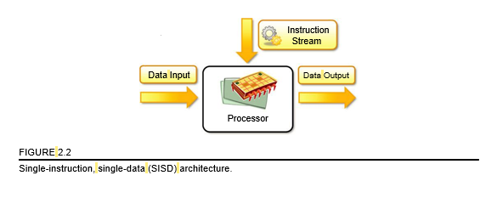
4.1. Single Instruction single Data systems (SISD)
An SISD computing system is a uniprocessor machine capable of executing a single instruction, which operates on a single data stream .
In SISD, machine instructions are processed sequentially; hence computers adopting this model are popularly called sequential computers.
Most conventional computers are built using the SISD model. All the instructions and data to be processed have to be stored in primary memory.
The speed of the processing element in the SISD model is limited by the rate at which the computer can transfer information internally.
Dominant representative SISD systems are IBM PC, Macintosh, and workstations.

Slide 10
4.2. single instruction multiple data stream (SIMD)
An SIMD computing system is a multiprocessor machine capable of executing the same instruction on all the CPUs but operating on different data streams.
Machines based on an SIMD model are well suited to scientific computing since they involve lots of vector and matrix operations.
For instance, statements such as
Ci = Ai*Bi
can be passed to all the processing elements (PEs); organized data elements of vectors A and B can be divided into multiple sets (N-sets for N PE systems); and each PE can process one data set.
Dominant representative SIMD systems are Cray’s vector processing machine and Thinking Machines’ cm .

Slide 11
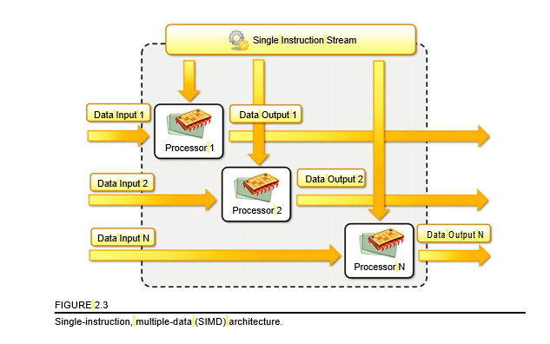
4.2. single instruction multiple data stream (SIMD)

Slide 12
4.3. Multiple instruction single data stream(MISD)
An MISD computing system is a multiprocessor machine capable of executing different instructions on different PEs but all of them operating on the same data set For instance, statements such as
y=sin(x)+cos(x)+tan(x)
perform different operations on the same data set.
Machines built using the MISD model are not useful in most of the applications; a few machines are built, but none of them are available commercially.
They became more of an intellectual exercise than a practical configuration.

Slide 13
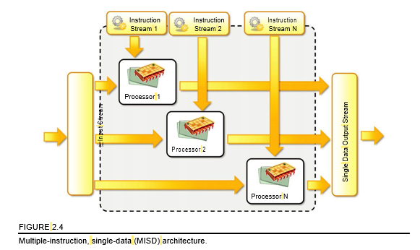
4.3. Multiple instruction single data stream(MISD)

Slide 14
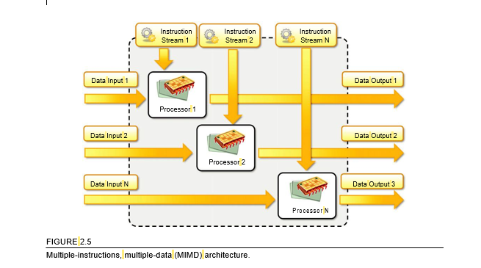
4.4. Multiple Instruction multiple data stream systems(MIMD)
An MIMD computing system is a multiprocessor machine capable of executing multiple instructions on multiple data sets .
Each PE in the MIMD model has separate instruction and data streams; hence machines built using this model are well suited to any kind of application.
Unlike SIMD and MISD machines, PEs in MIMD machines work asynchronously.
MIMD machines are broadly categorized into two based on the way PEs are coupled to the main memory
Shared-memory MIMD and Distributed-memory MIMD.

Slide 15
4.4. Multiple Instruction multiple data stream systems(MIMD)
Shared memory MIMD machines
In the shared memory MIMD model, all the PEs are connected to a single global memory and they all have access to it.
Systems based on this model are also called tightly coupled multiprocessor systems.
The communication between PEs in this model takes place through the shared memory; modification of the data stored in the global memory by one PE is visible to all other PEs.
Dominant representative shared memory MIMD systems are Silicon Graphics machines and Sun/IBM’s SMP (Symmetric Multi-Processing).

Slide 16
4.4. Multiple Instruction multiple data stream systems(MIMD)
Distributed memory MIMD machine
In the distributed memory MIMD model, all PEs have a local memory.
Systems based on this model are also called loosely coupled multiprocessor systems.
The communication between PEs in this model takes place through the interconnection network (the interprocess communication channel, or IPC).
The network connecting PEs can be configured to tree, mesh, cube, and so on. Each PE operates asynchronously, and if communication/synchronization among tasks is necessary, they can do so by exchanging messages between them

Slide 17
4.4. Multiple Instruction multiple data stream systems(MIMD)
The shared-memory MIMD architecture is easier to program but is less tolerant to failures and harder to extend with respect to the distributed memory MIMD model. Failures in a shared-memory MIMD affect the entire system, whereas this is not the case of the distributed model, in which each of the PEs can be easily isolated.
Moreover, shared memory MIMD architectures are less likely to scale because the addition of more PEs leads to memory contention. This is a situation that does not happen in the case of distributed memory, in which each PE has its own memory.

Slide 18
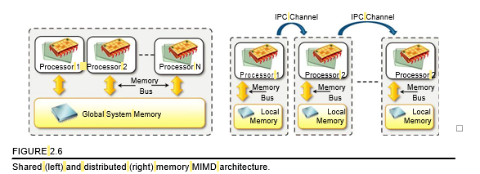
4.4. Multiple Instruction multiple data stream systems(MIMD)

Slide 19
5. Approaches to parallel programming
A sequential program is one that runs on a single processor and has a single line of control.
To make many processors collectively work on a single program, the program must be divided into smaller independent chunks so that each processor can work on separate chunks of the problem. The program decomposed in this way is a parallel program.
A wide variety of parallel programming approaches are available. The most prominent among them are the following:
Data parallelism
Process parallelism
Farmer-and-worker model
These three models are all suitable for task-level parallelism.

Slide 20
5. Approaches to parallel programming
In the case of data parallelism, the divide-and-conquer technique is used to split data into multiple sets, and each data set is processed on different PEs using the same instruction. This approach is highly suitable to processing on machines based on the SIMD model.
In the case of process parallelism, a given operation has multiple (but distinct) activities that can be processed on multiple processors.
In the case of the farmer-and-worker model, a job distribution approach is used: one processor is configured as master and all other remaining PEs are designated as slaves; the master assigns jobs to slave PEs and, on completion, they inform the master, which in turn collects results. These approaches can be utilized in different levels of parallelism.

Slide 21
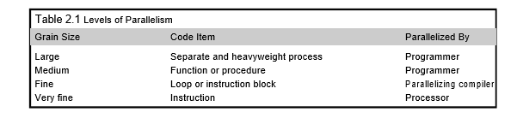
6. Levels of parallelism
Levels of parallelism are decided based on the lumps of code (grain size) that can be a potential candidate for parallelism.
Table lists categories of code granularity for parallelism.
All these approaches have a common goal: to boost processor efficiency by hiding latency.
To conceal latency, there must be another thread ready to run whenever a lengthy operation occurs. The idea is to execute concurrently two or more single-threaded applications, such as compiling, text formatting, database searching, and device simulation.
As shown in the table and depicted in, parallelism within an application can be detected at several levels:
Large grain (or task level), Medium grain (or control level), Fine grain (data level), Very fine grain (multiple-instruction issue)

Slide 22
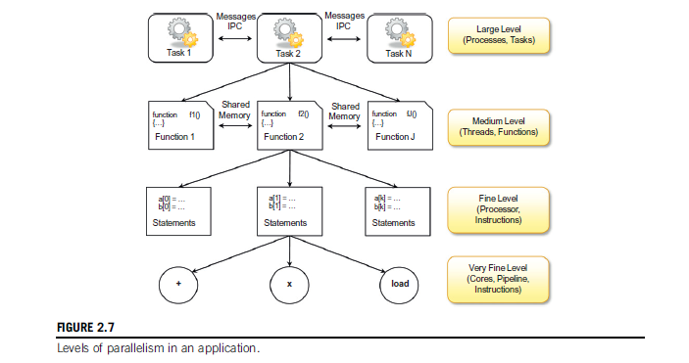
6. Levels of parallelism

